Slide 1
READY FOR REDDIT?
Presentation to the
Brand Management Team
Pernod Ricard Wine & Champagne Portfolio

Slide 2
OVERVIEW
Brand Team request
Is there an opportunity?
Methodology
Analysis
Recommendations and Next Steps

Slide 3
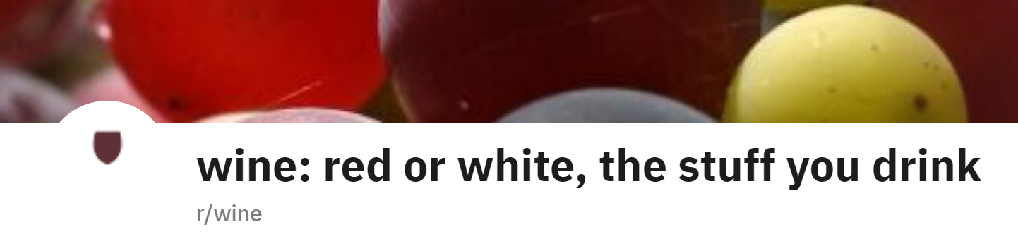
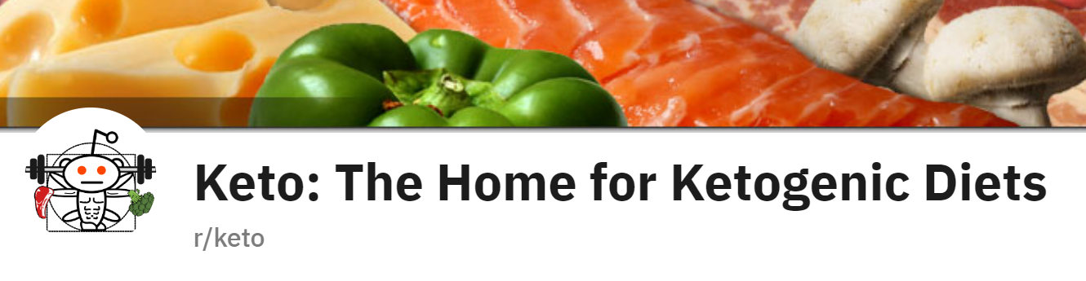
BRAND TEAM REQUEST
Seeking new awareness opportunities
Specifically inquired about increasing exposure on reddit
Why?
Brand Team has experimented with r/wine
Keto is a larger user base: (r/wine = 106k and r/keto = 1.7m)
Perceived Lifestyle Fit – they are asking about wine online

Slide 4
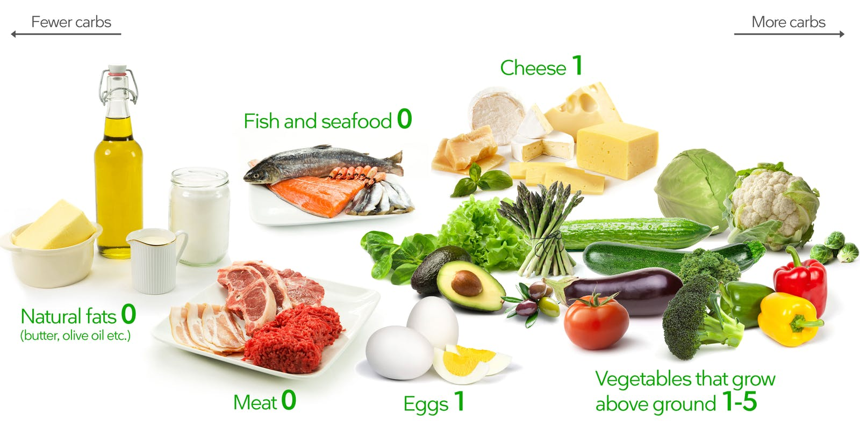
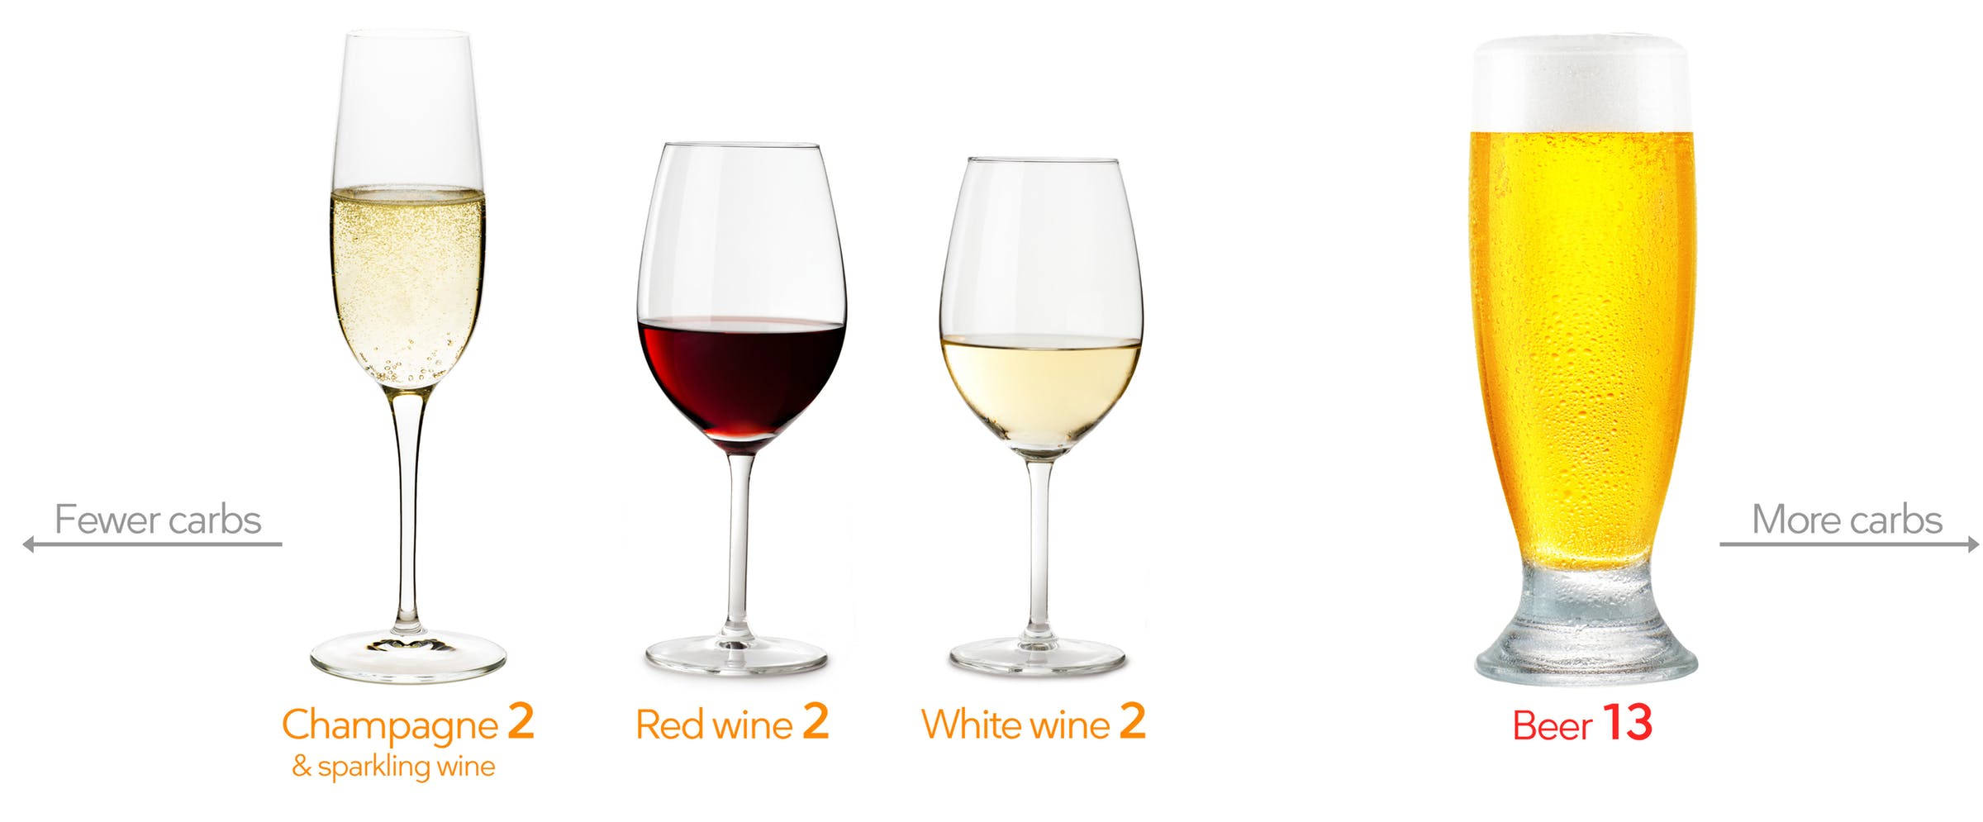
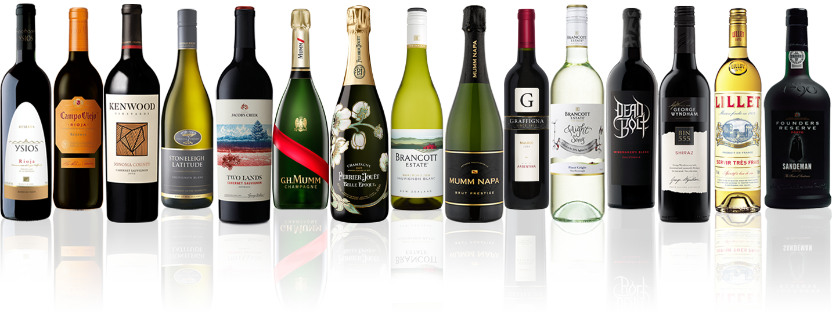
IS THERE AN OPPORTUNITY?
80% fat and low carbs, but “pairable” recipes
REALLY want to rationalize not giving up alcohol
MANY portfolio wine brands fit the ideal profile

Slide 5
METHODOLOGY
QUESTION:
Can we infer if the r/wine and r/keto subreddits are similar or different?
IMPLICATIONS:
If similar, it may be an investment opportunity to drive trial and awareness of brands among keto consumers.
If not, more evaluation will be needed.
APPROACH:
Capture an equal amount of text based reddit posts from both subreddits (2800 each)
Use Natural Language Programming (NLP) and Text Feature Extraction methods to classify reddit posts
Build regression models that will help address the question
Evaluate results and share recommendations

Slide 6
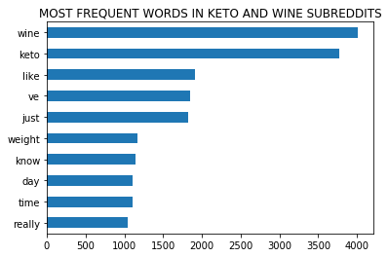
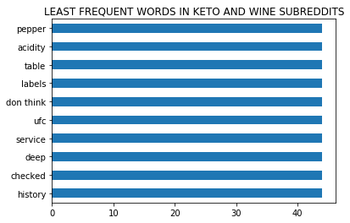
ANALYSIS

Slide 7
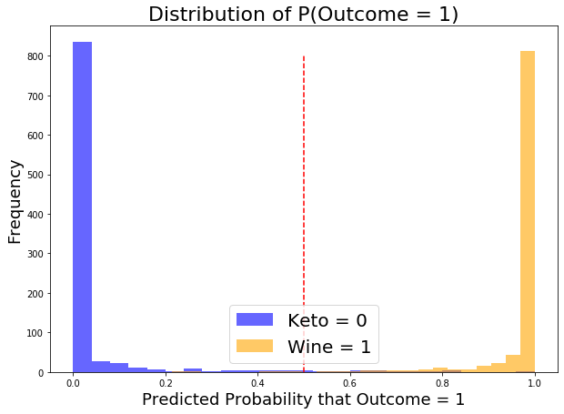
ANALYSIS
OBSERVATIONS
Distribution of outcomes show a very clear distinction between these two subreddits
Even if the two words with the highest frequency were removed from the analysis, there would be very little overlap in their distribution

Slide 8
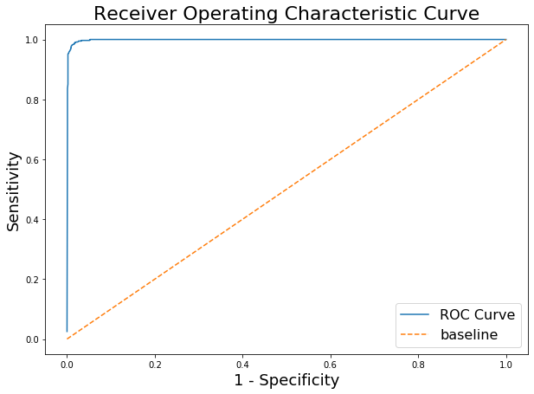
ANALYSIS
ACCURACY
98.4% of observations predicted correctly
High accuracy infers the two subreddits are dissimilar
ROC CURVE
99.2% sensitivity indicates we are correctly predicting positives
Baseline – no majority (50/50)
The further away from the baseline, the more difference is inferred

Slide 9
Recommendations and Next Steps
Activating r/keto not viable without more analysis at this time
It could be a great “wine pairing” marketing opportunity
This particular forum may not be ready for it
Consider evaluating other subreddits
r/weight watchers (41k), r/loseit (2.0m), r/nutrition(684k)
Open analysis to other social media platforms and channels

